Slide 1


FINAL PRESENTATION
MINI PROJECT-2B PRESENTATION

Slide 2
TE-COMP
SEM-VI(2023-2024)

Slide 3
IoT-Based Vehicle Location and Speed Monitoring for Parental Peace of Mind
Group members
1)Mariyum Siddique | 62 | 211P023
2)Aimaan Khan | 14 | 211P039
3)Pranali Thorat | 33 | 211P064
Name of the Guide: Prof Manila Gupta

Slide 4
Index
1. Introduction
2. Need / Motivation
3. Problem Definition
4. Literature Survey
5. Existing Methodology
6. Challenges in Existing Methodology
7. Proposed System
8. Hardware and Software Requirements
9. Implementation and Results
10. Conclusion and Future Scope
11. References

Slide 5
INTRODUCTION
Project: IoT-Based Vehicle Location and Speed Monitoring
Purpose: Enhance parental peace of mind through real-time vehicle monitoring.

Slide 6
NEED / MOTIVATION
Safety Concerns: Parents worried about young drivers’ safety.
Real-Time Monitoring: Need for immediate updates on vehicle location and speed.

Slide 7
PROBLEM DEFINITION
The problem addressed is the lack of real-time and reliable vehicular monitoring systems that ensure young drivers' safety without compromising privacy or requiring extensive vehicle modification.

Slide 8
LITERATURE SURVEY
Existing Apps: Basic tracking but no real-time speed alerts.
Telematics Devices: Detailed data but not directly to parents.
IoT Devices: Require vehicle modifications.

Slide 9
EXISTING METHODOLOGY
The survey discusses various existing methods like smartphone-integrated systems and dedicated IoT devices, noting their dependency on reliable network connectivity and vehicle integration

Slide 10
CHALLENGES IN EXISTING METHODOLOGY
Network and hardware reliability,
Privacy issues,
Cost,
Accessibility constraints.

Slide 11
PROPOSED METHODOLOGY
Components: ESP32 WROOM DEVKIT, MPU6050 sensor, NEO 6M GPS.
Privacy-Focused: No reliance on vehicle's diagnostic ports.

Slide 12
HARDWARE AND SOFTWARE REQUIREMENTS
Hardware:
ESP32 DEVKIT,
MPU6050,
NEO 6M GPS.
Software:
Blynk platform,
Arduino IDE,
custom ESP32 firmware.

Slide 13
IMPLEMENTATION
Hardware Integration: ESP32 DEVKIT, MPU6050 sensor, NEO 6M GPS module.
Software Development:
Blynk platform for user interface.
Arduino IDE for programming ESP32.
Custom firmware for data processing and communication.
System Setup:
Establishing Wi-Fi connectivity and sensor integration.
Real-time data communication setup through Blynk platform.

Slide 14
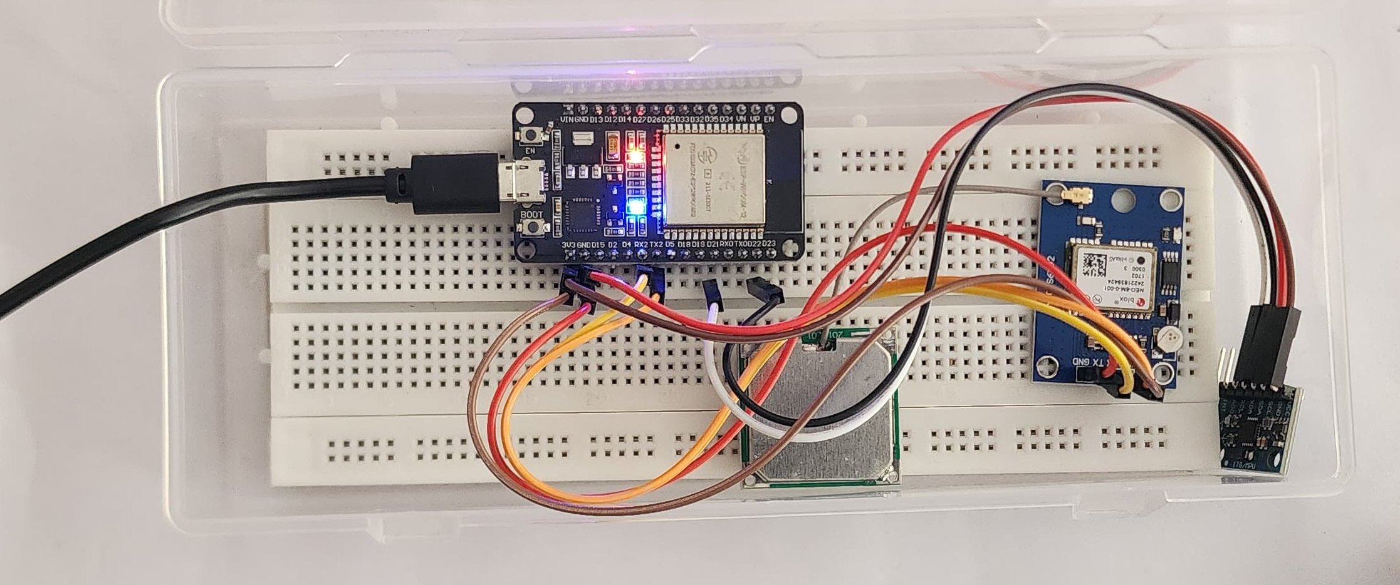
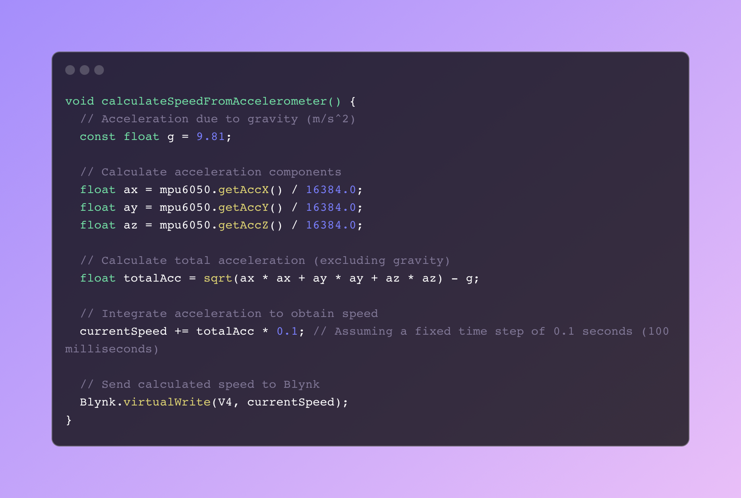
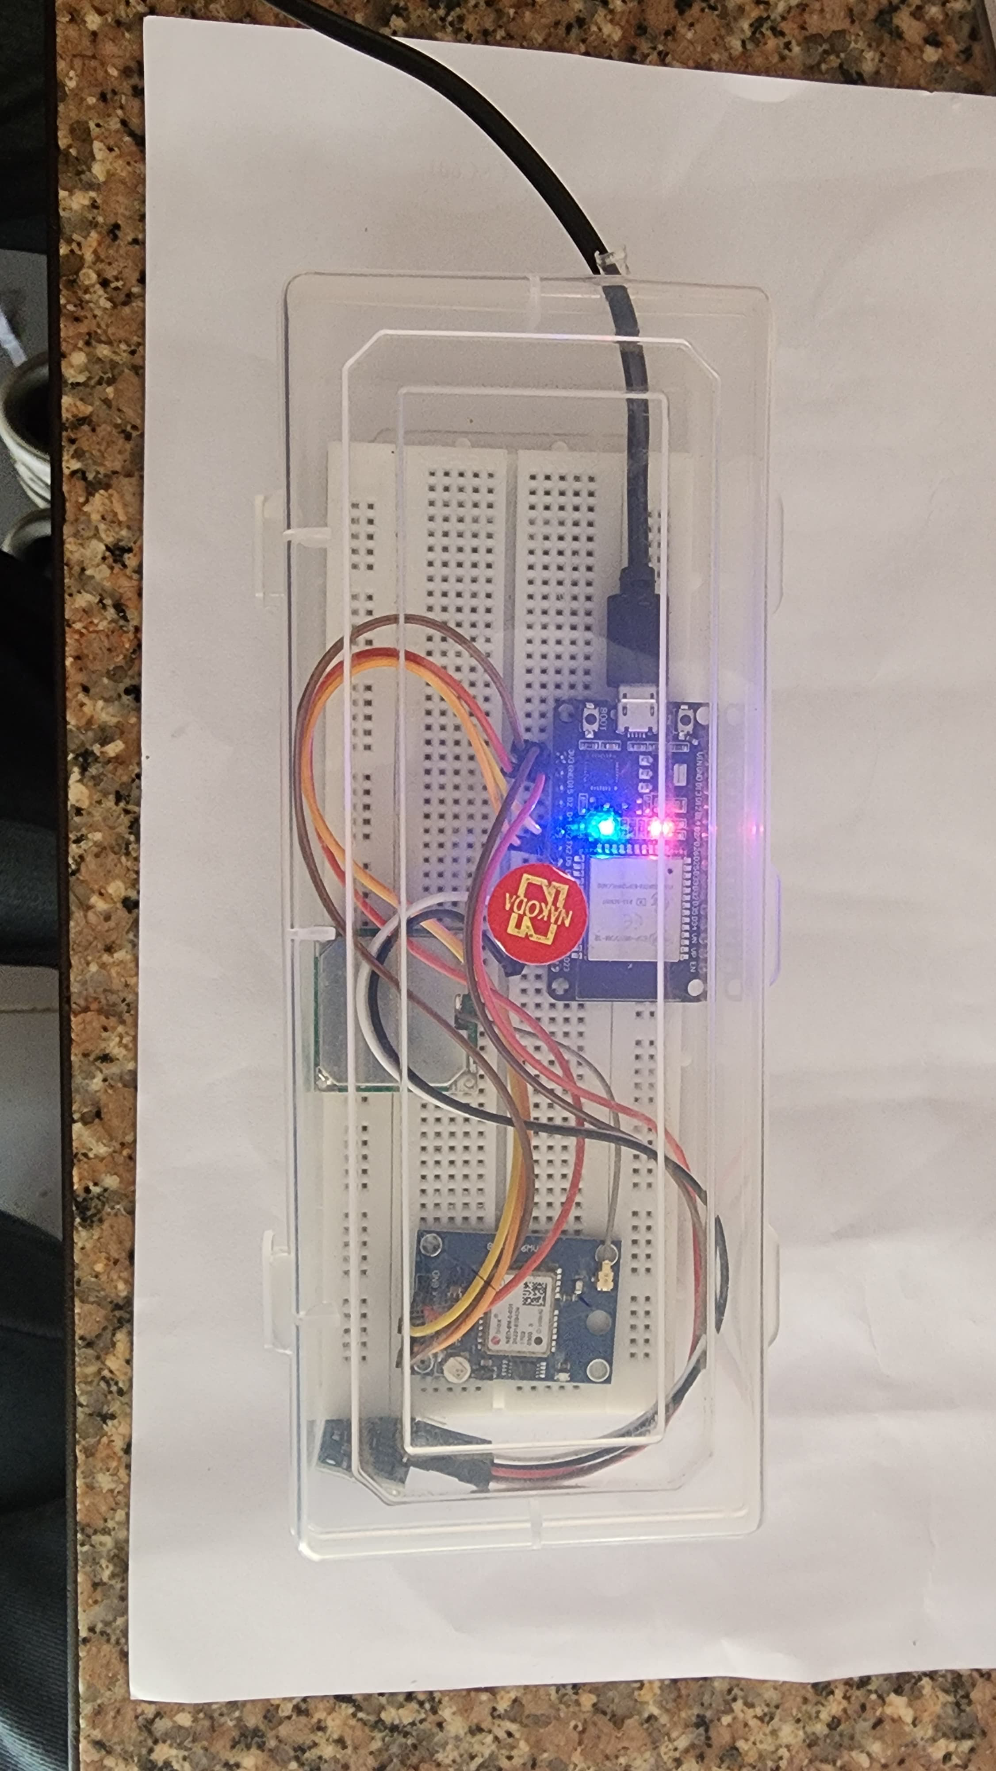
IMPLEMENTATION

Slide 15
RESULTS
Component Testing:
Accuracy verification for MPU6050's sensitivity and gyroscopic data.
GPS module tested for location precision.
System Integration Testing:
Combined testing of all components in the ESP32 system.
Evaluation under controlled and real-world driving scenarios.
Outcome:
High reliability in event detection (e.g., sudden stops, sharp turns).
Successful real-time notification delivery to the Blynk platform.

Slide 16
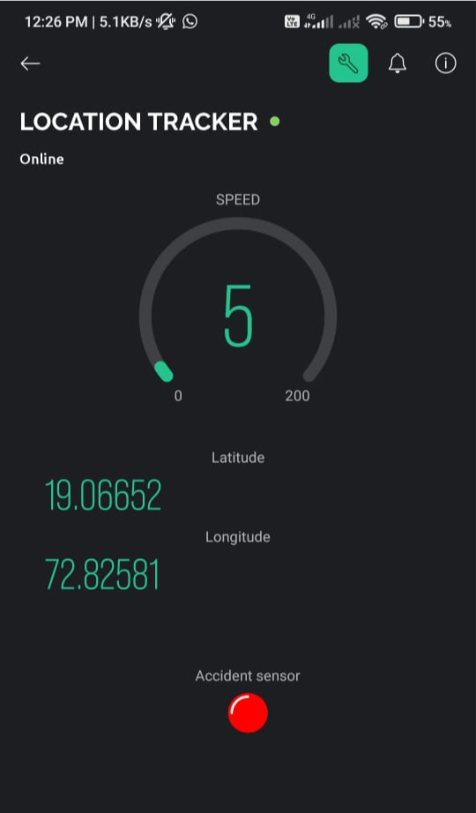
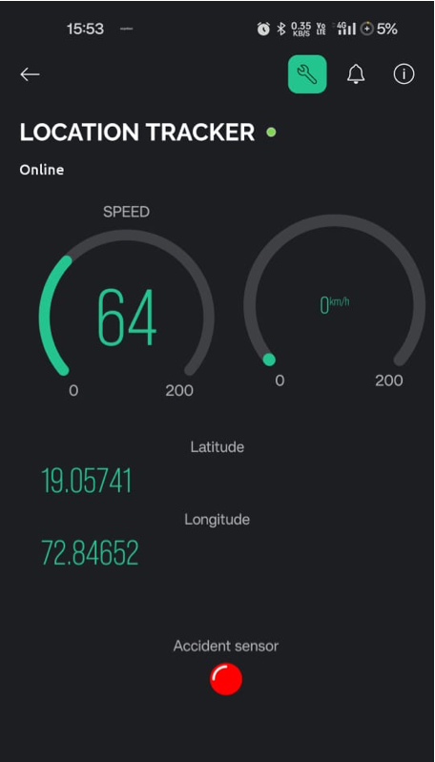
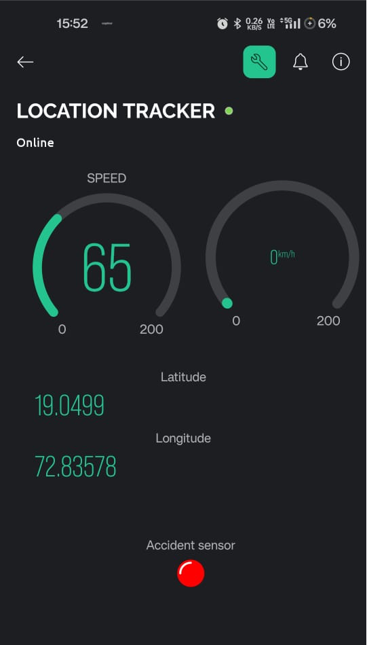
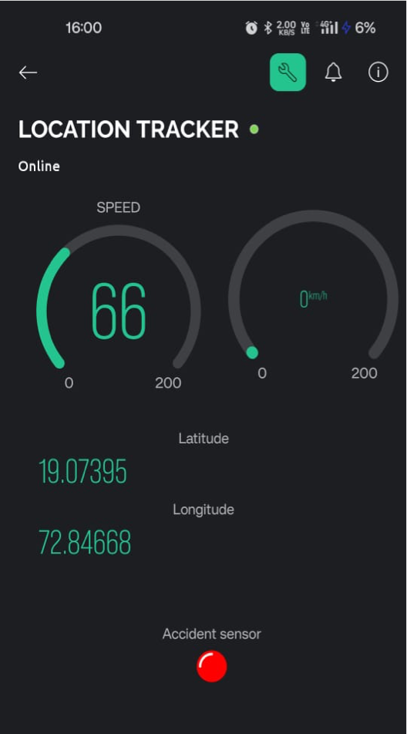
RESULTS

Slide 17
CONCLUSION
Effective Monitoring: Real-time updates on vehicle speed and location.
Privacy Considerations: Independent of vehicle diagnostics, enhancing privacy.
Enhanced Safety: Promotes safer driving habits among young drivers.
Proven Reliability: System tested for accuracy and responsiveness.

Slide 18
FUTURE SCOPE
Machine Learning: Integrate algorithms to predict hazardous behaviours.
Sensor Expansion: Incorporate additional sensors for comprehensive diagnostics.
Smart City Integration: Interface with smart infrastructure for broader safety applications.
Commercial Potential: Explore scalability and cost-reduction for wider adoption.

Slide 19
REFERENCES
Aishwarya S.R, Ashish Rai, Charitha, Prasanth M.A, and Savitha S.C, "An IoT-based vehicle accident prevention and tracking system for night drivers," proc. IEEE, vol.3, no.4, pp. 2320-9798, 2015.
Sadhana B Shabrin, Bhagyashree Jagadish Nikharge, Maithri M Poojary, and T Pooja, "Smart helmet-intelligent safety for motorcyclist using raspberry pi and open CV," proc.IEEE, vol.03, no.03, pp. 2395-0056, 2016.
Jagdish A. Patel, Aringale Shubhangi, Shweta Joshi, Aarti Pawar, and Namrata Bari, "Raspberry Pi-based smart home," Proc. IEEE, vol.6, no.3, pp. 2321-3361, 2016.
Dr. Pankaj Tomar and Preeti Mehta, "An Efficient Management System based on Face Recognition using Matlab and Raspberry Pi 2," Proc-IEEE, vol.3, no.5, pp. 239, 2016.
T. Anitha and T. Uppalaigh, "Android based home automation using Raspberry pi," Proc-IEEE, vol.04, no.01, pp. 2351-8665, 2016.

